Slide 1
Pulse Discrimination
Prepared by:
Tatsu
CrocKim

Slide 2
Overview
Chip will take in several different pulses produced by a scintillator connected to an oscilloscope and discriminate between them.
This process is known as pulse discrimination.
Quite useful in areas of research where researchers wish to remove background noise (typically background radiation or to discriminate between neutron and gamma recoils).
Our design makes the whole process extremely convenient for the consumers. Currently, most researchers spend a lot of time writing the code for the entire process and run into several issues. Our chip would simplify the procedure and provide them with the output they want.

Slide 3
System Design
The input to our design is the output of a scintillator connected to an analog to digital converter.
A scintillator is a material that exhibits luminescence when excited by ionizing radiation.
An incoming particle excites electrons to higher energy levels, after which when they go to a lower energy level, they emit a photon.
The photons are then detected by photomultiplier tubes (vacuum tubes that essentially multiply the low input signal to a larger value).
This output is read as a ‘pulse’ and is then fed to an analog to digital converter.

Slide 4
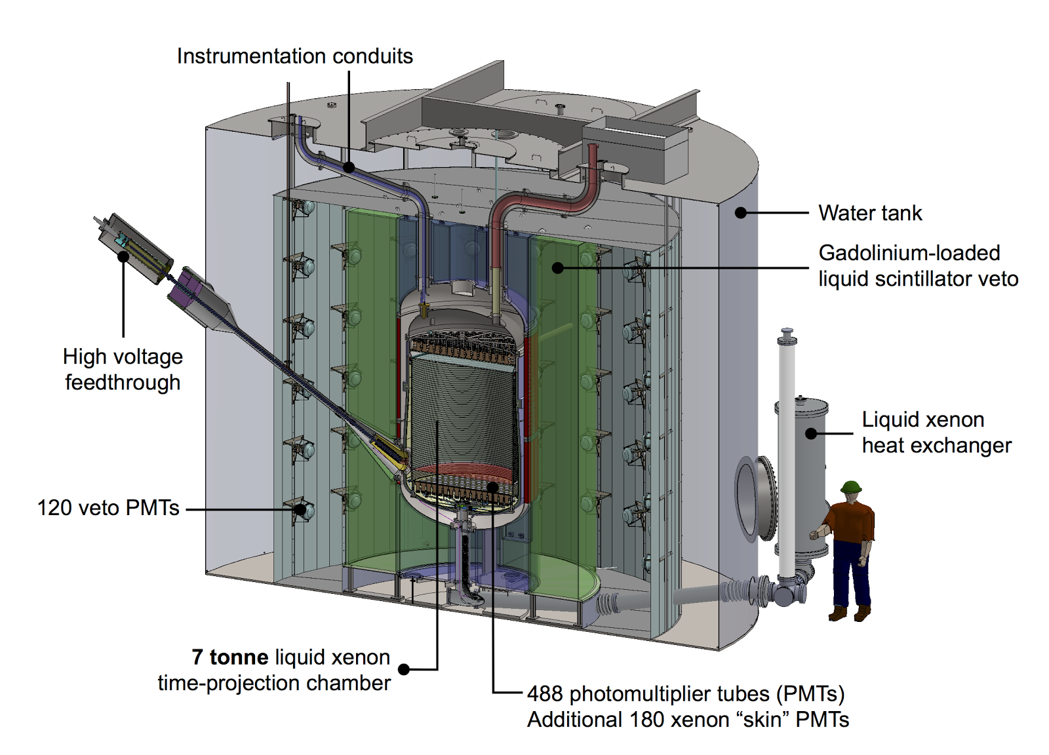
System Design
Figure 1: Example of liquid Xenon scintillator [1].

Slide 5
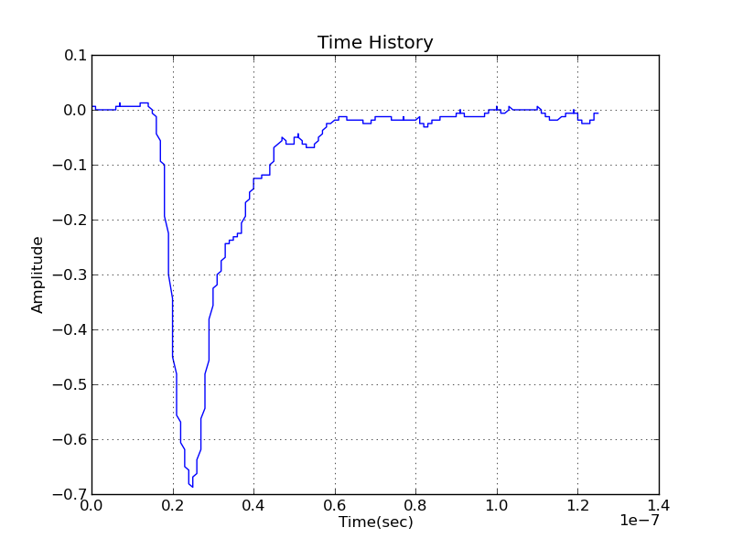
System Design
Figure 2: Example of a pulse output from the scintillator [2].

Slide 6
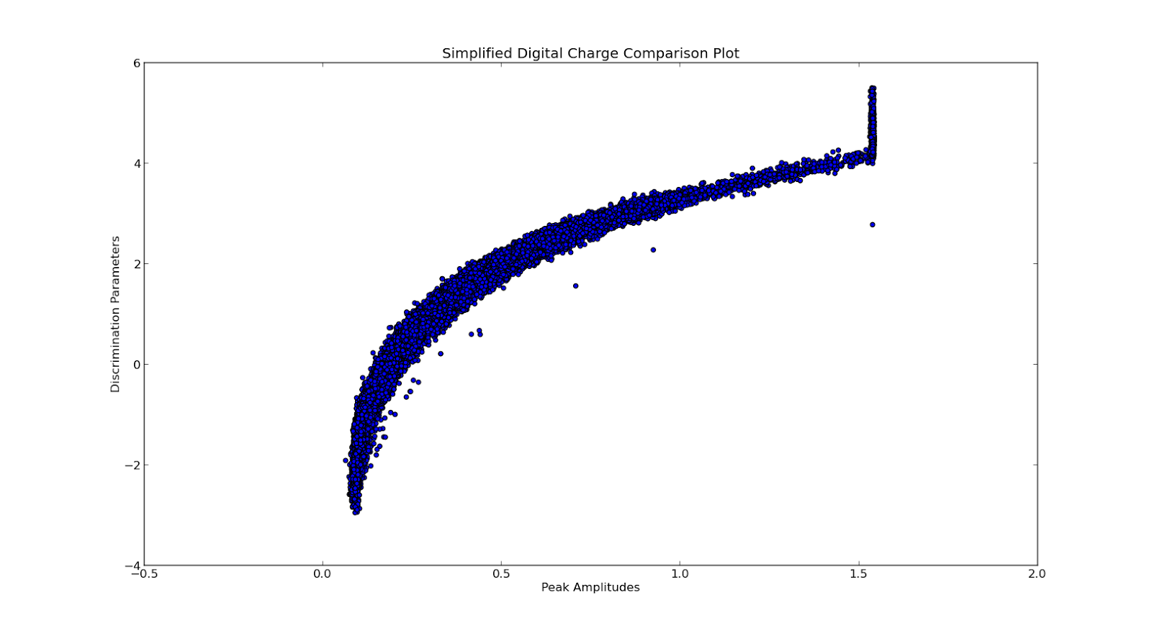
System Design
Figure 3: Sample output of the SDCC algorithm.

Slide 7
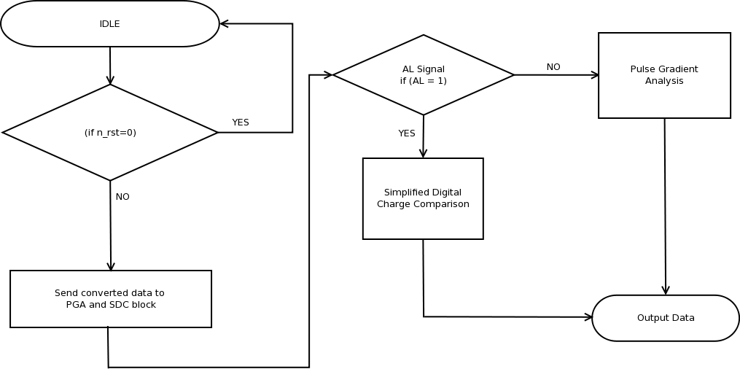
System Design: Flow Chart

Slide 8
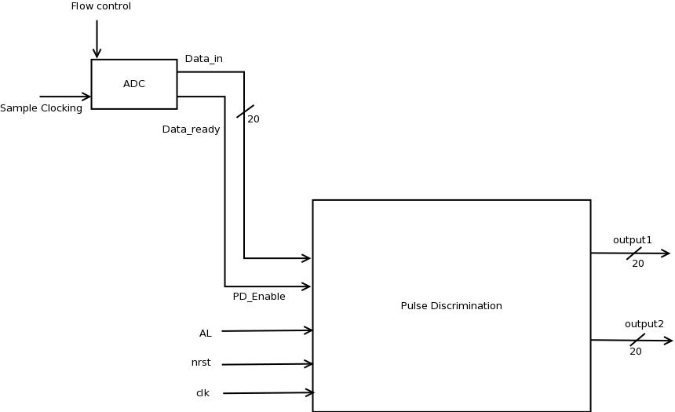
System Design: System Level Diagram

Slide 9
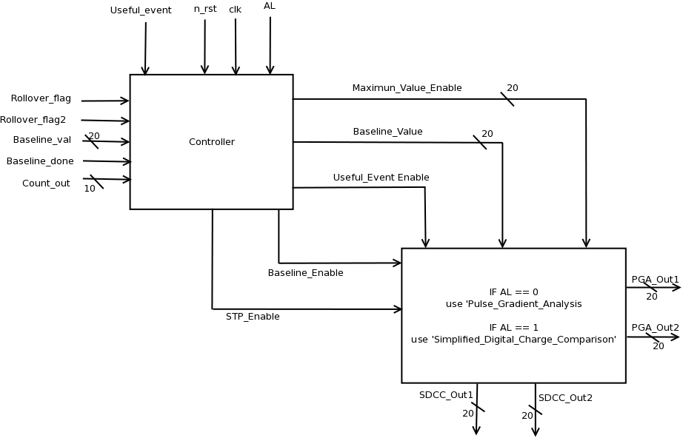
System Design: Architecture Diagram

Slide 10
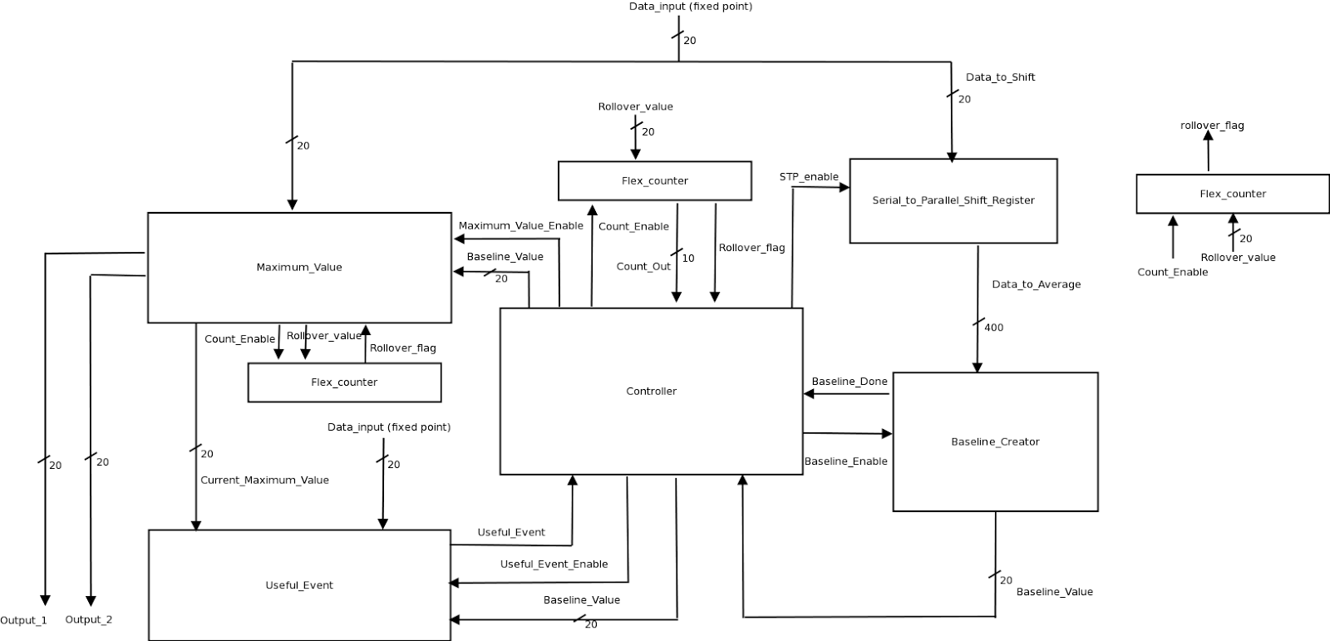
Pulse Gradient Analysis Block

Slide 11
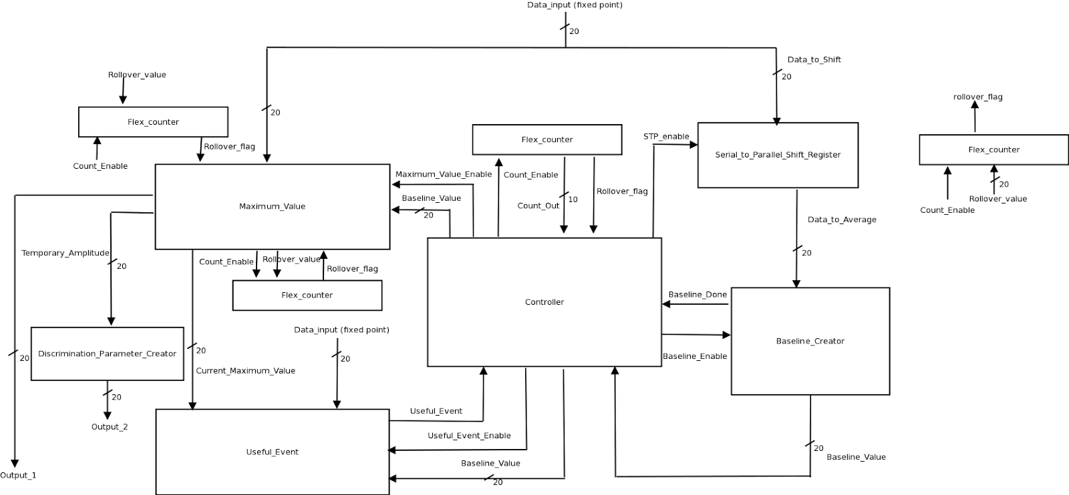
Simplified Digital Charge Comparison Block
400

Slide 12
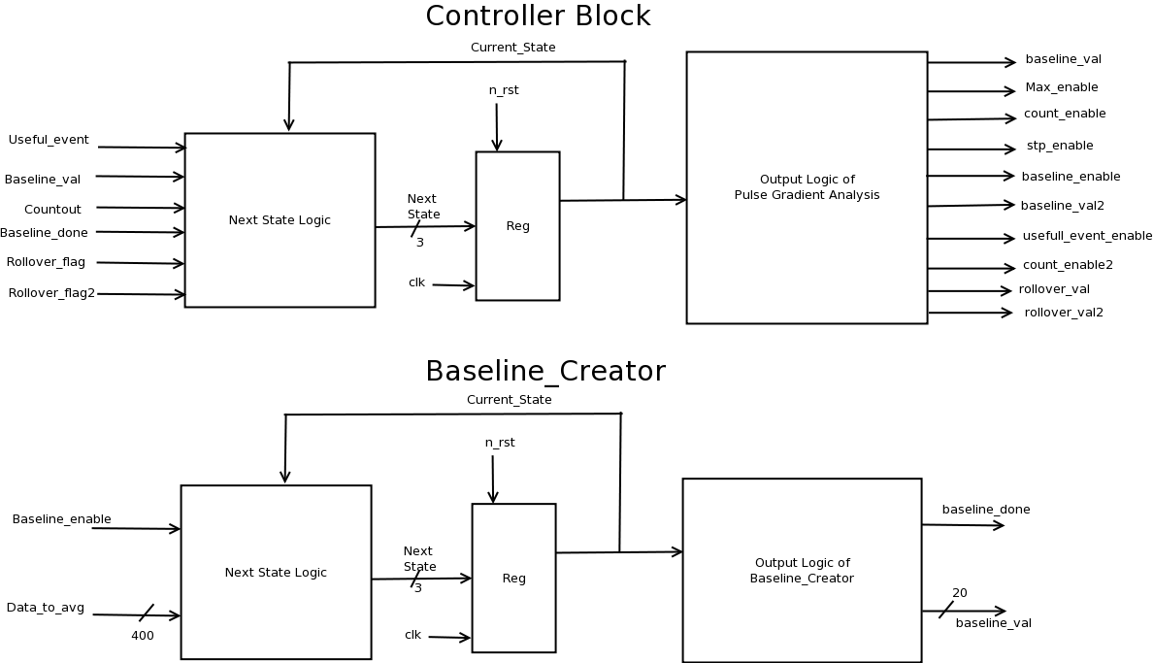
RTL Diagram

Slide 13
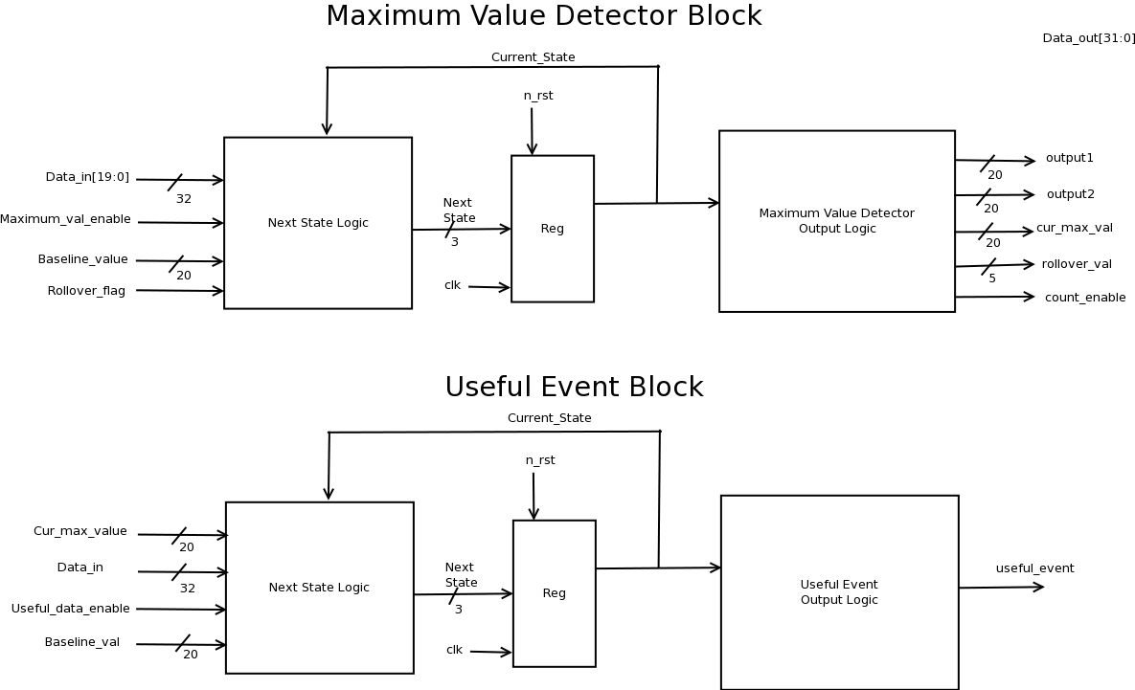
RTL Diagram

Slide 14
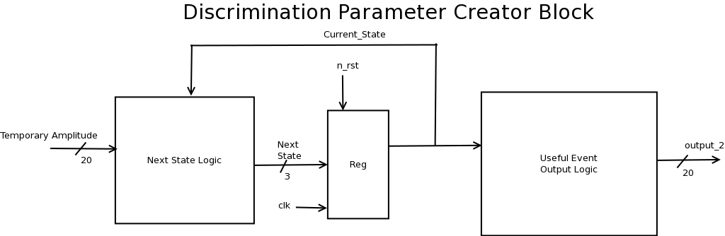
RTL Diagram

Slide 15
Results: Success Criteria
(1 point) Demonstrate by simulation of Verilog testbench to check functionality and correctness of Useful_Event Block by using alternative implementation (Python program) of the part.
The useful_event block rejects any pulse or event where the data after the maximum value does not go below the baseline.
Our testbench tests several cases where we make the stream of data enter the block with some values above and below the baseline and check whether the pulse is rejected or not.

Slide 16
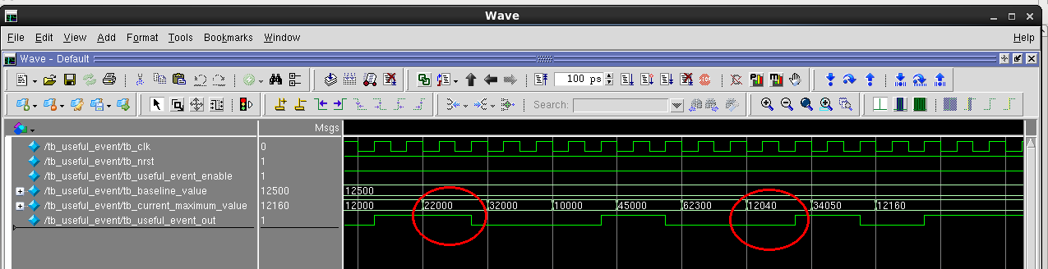
Results: Useful Event

Slide 17
Results: Success Criteria
(1 point) Demonstrate by simulation of Verilog testbench to check functionality and correctness of Maximum_value Block by using alternative implementation (Python program) of the part.
The Maximum_Value block takes in a stream of data and determines the largest or maximum value in the pulse.

Slide 18
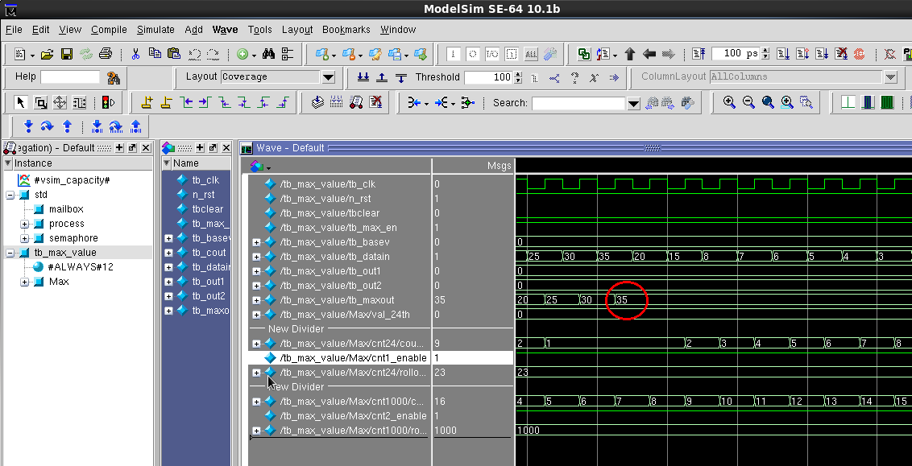
Results: Maximum_Value

Slide 19
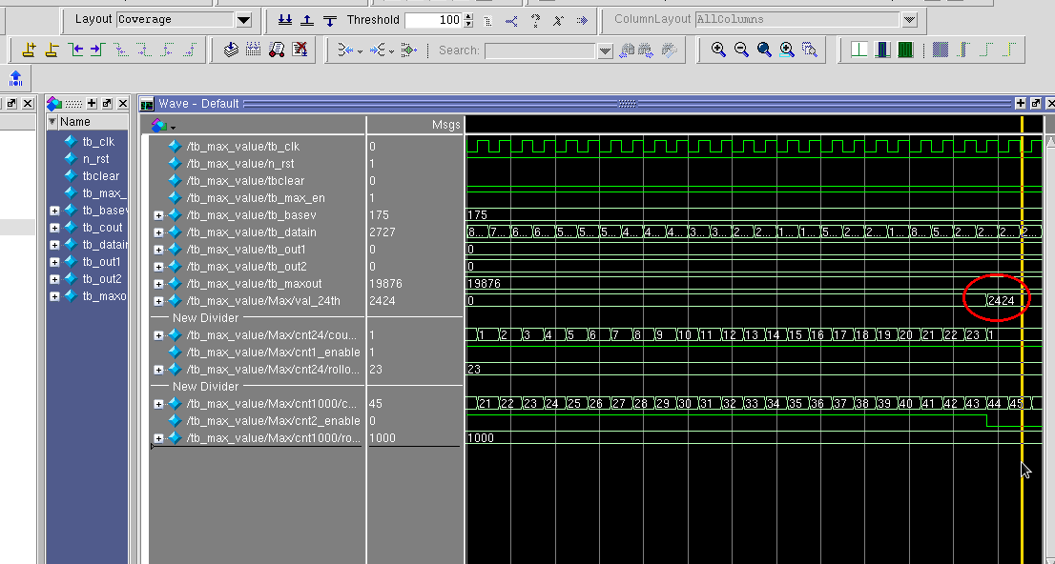
Results: Maximum_Value

Slide 20
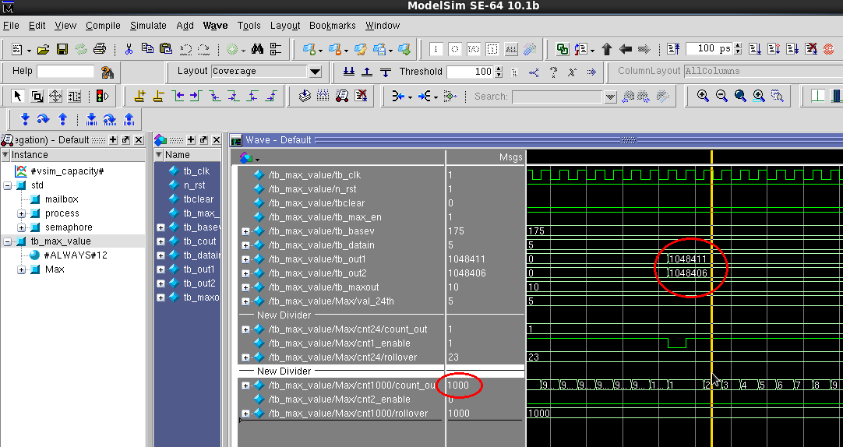
Results: Maximum_Value

Slide 21
Results: Success Criteria
(1 point) Demonstrate by simulation of Verilog testbench to check functionality and correctness of Baseline_Creator Block by using alternative implementation (Python program) of the part.
The baseline_creator takes the average of the first twenty values and sets this as the baseline.

Slide 22
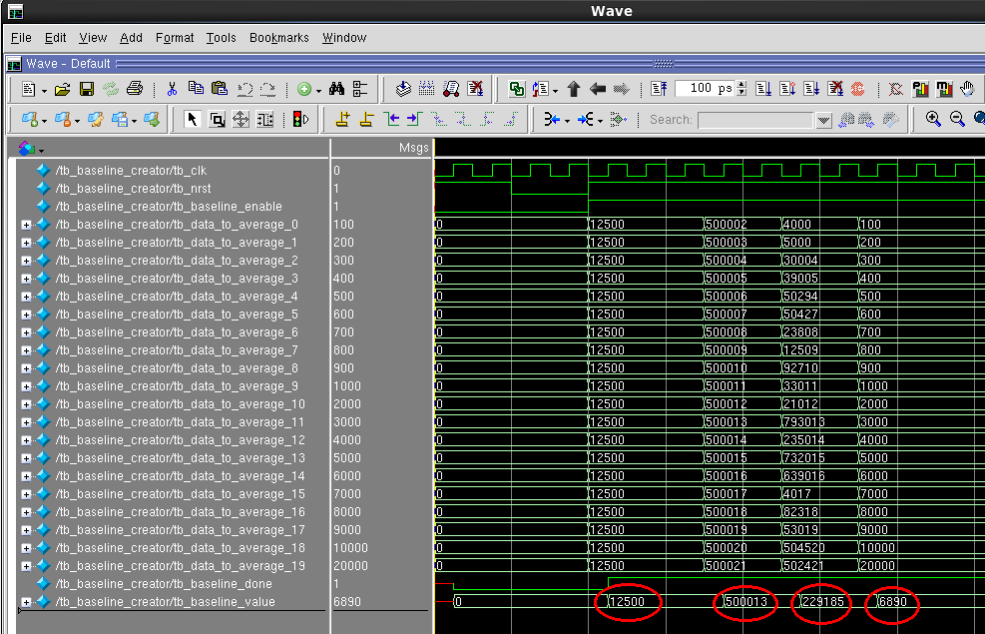
Results: Baseline_Creator

Slide 23
Results: Success Criteria
(1 point) Demonstrate by simulation of Verilog testbench to check functionality and correctness of PTP20 Block by using alternative implementation (Python program) of the part.
The PTP20 block takes in 20 data values and outputs them in parallel to speed up the addition tree in the baseline_creator block.

Slide 24
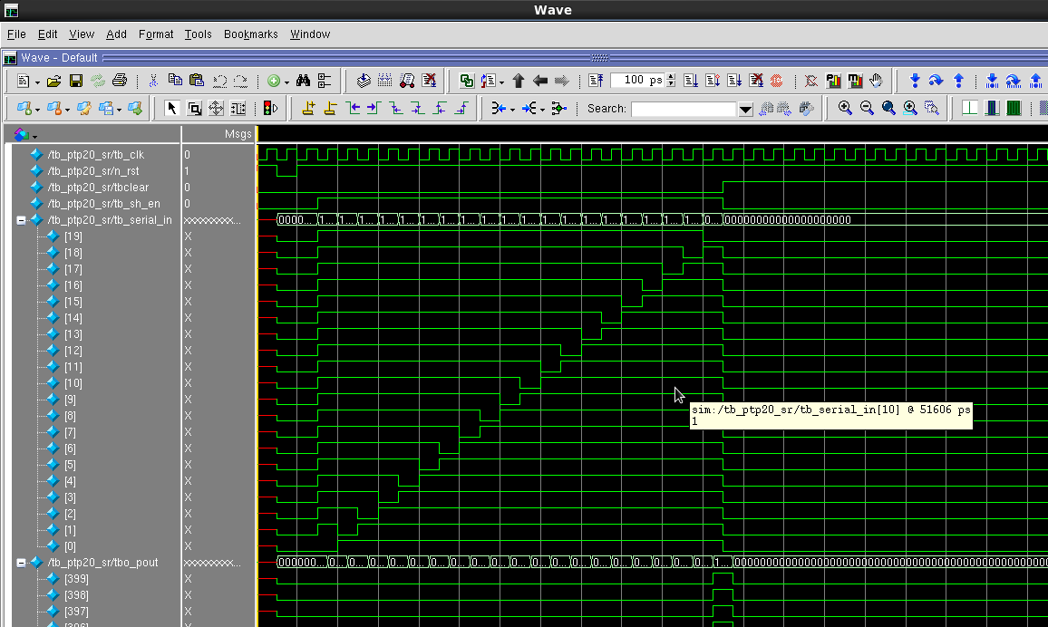
Results: PTP20 Block

Slide 25
Results: Success Criteria
(1 point) Demonstrate by simulation of Verilog testbench to check functionality and correctness of Discrimination_Parameter_Creator Block by using alternative implementation (Python program) of the part.
The discrimination_parameter_creator block takes in each pulse and performs a calculation on the data to create a discrimination parameter- which is a vital part of the SDCC algorithm.

Slide 26
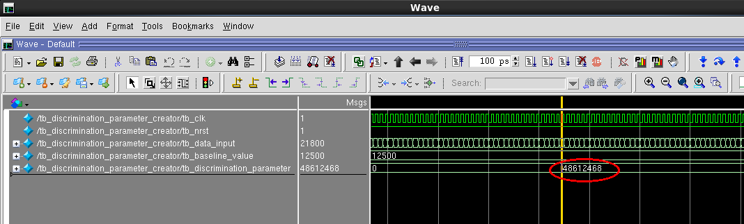
Results: Discrimination_Parameter

Slide 27
Results: Success Criteria
(1 point) Demonstrate by simulation of Verilog testbench to check correctness of the output of the design with alternative implementation (Python program) of algorithm.

Slide 28
Results: Success Criteria
(1 points) Demonstrate by simulation of Verilog testbench that the design is able to correctly use the pulse gradient analysis algorithm.

Slide 29
Results: Success Criteria
(1 points) Demonstrate by simulation of Verilog testbench that the design is able to correctly use the simplified digital charge comparison algorithm.

Slide 30
Results: Layout
Area Budget:
Number of I/O pads: 65
I/O Pad Dimensions: 1200 x 1200μm²
I/O Based Padframe Dimensions: 300 x 300μm²
Core Dimensions: 5200 x 5200μm²
Core Based Padframe Dimensions: 5500 x 5500μm²
Final Padframe Dimensions: 5500 x 5500μm²
Final Chip Area: 30,244,712 μm²
Timing Budget:
Total Path Delay of Controller to Pulse Gradient Analysis Block: 6ns
Total Path Delay of Controller to Simplified Digital Charge Comparison Block: 8ns

Slide 31
Conclusions
The biggest challenge in doing the design was putting all the blocks together without violating any timing constraints.
Another challenge was the size of the data we were dealing with.
If we had to redo our design, we would probably implement an I2C bus.
We would get the entire design to stop giving timing violations and communicate correctly.

Slide 32
References
[1] Kudryavtsev, Vitaly, Elena Korolkova, and David Woodward. "Dark Matter Research." Dark Matter Research. N.p., n.d. Web. 09 Dec. 2014.
[2] Rafael Lang, Dark Matter Laboratory Data, Purdue Physics Department (2014).

